Slide 1


Advisor : Hoon Sung Chwa
Weekly Meeting
2023.03.02
Dept of Information & Communication Engineering, DGIST
Real-Time Computing Lab
Kang Young Eun ( kye0520 @dgist.ac.kr)

Slide 2
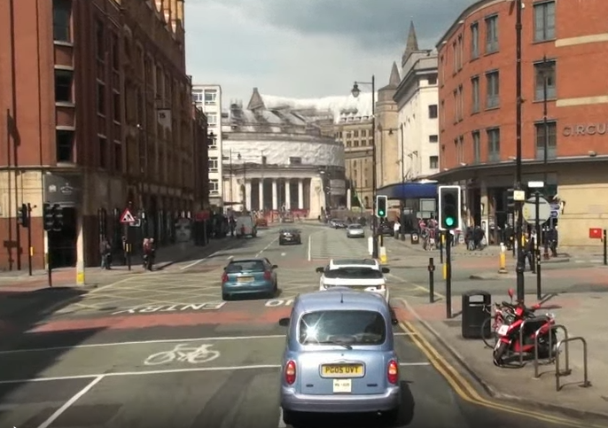
Image patching
Calculating only important instances(RoIs) will help lower computation.
Original Input Image
RoI Extraction
RoI Patched Image
Q1. How to extract Region of Interest?
Q2. How does Image Patching impact detection accuracy?
2

Slide 3
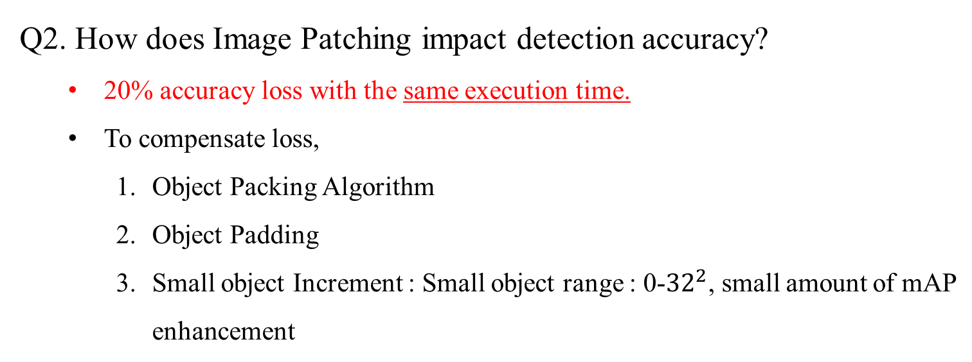
Summary
Q1. How to extract Region of Interest?
Yolo localization
Merging image benefits in 1.4x of execution time
Localization accuracy is insensitive to image downsizing.
Q2. How does Image Patching impact detection accuracy?
20% accuracy loss with the same execution time.
To compensate loss,
Object Packing Algorithm
Object Padding
Small object Increment : Small object range : 0-${32}^{2}$, small amount of mAP enhancement
3

Slide 4
Content
Image Patching Accuracy
Solutions for Enhancing Accuracy
Object Padding
Object Packing Algorithm
Small Object Increment
4

Slide 5
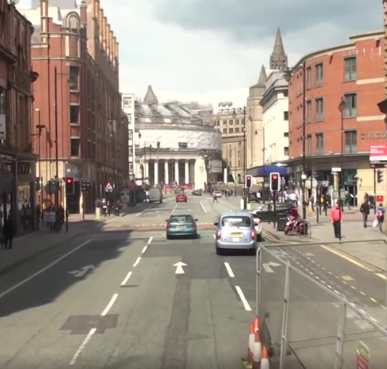
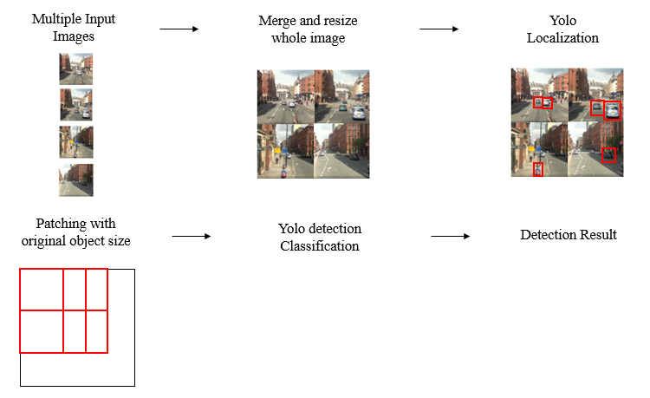
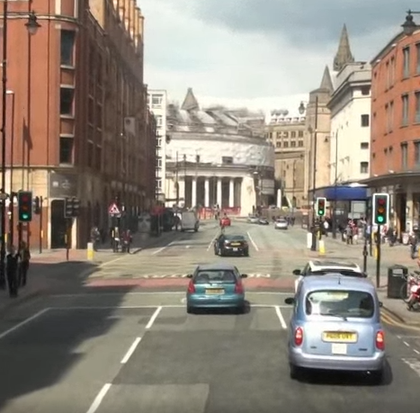
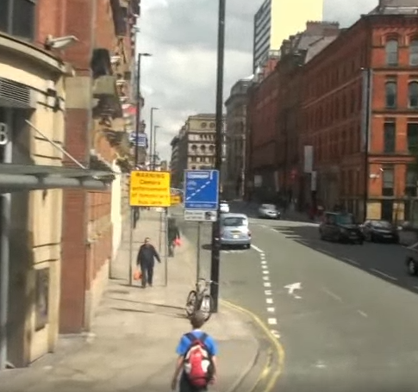
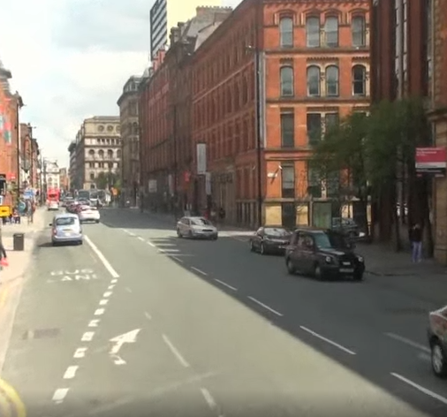
Accuracy of Patching
Experiment Setup
Accuracy with no limit of patching frame size
Vanilla YOLO
Image Patching
Detection
Network
Result
Image width = 1280
all objects in original image size of 1920
Patch frame size fits all objects
Image width = 1280, 640
5
Notes:
Object size는 어떻게 할지 설정을 하지 않은 상태이기 때문에.
Original object size로, frame size도 object가 모두 frame 안에 들어갈 수 있도록 설정하여 detection 진행.

Slide 6
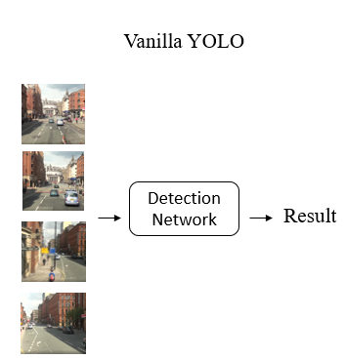
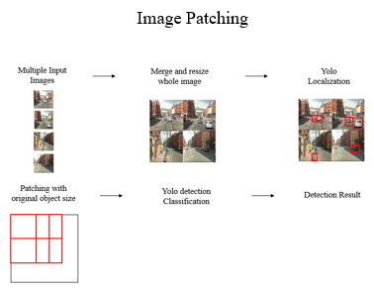
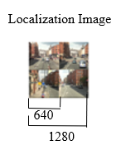
Accuracy of Patching
Accuracy results of patching
One Image size = 640
14.06 mAP ↑
Additional patching increases detection accuracy up to 14.06.
6
Notes:
1번째로 확인할 수 있는 것은 추가적으로 patching을 진행했을 때 accuracy가 늘어난다는 것.
Vanilla yolo로 640을 진행했을 때와 640을 localizatio으로 진행하고 추가로 원본 size로 patchin해서 detection을 진행한 결과.
추가적으로 patchin을 진행했을 때 14.06의 map 향상을 할 수 있었다는 것을 확인.

Slide 7
Accuracy of Patching
Accuracy results of patching
6.07 mAP ↓
One Image size = 1280
Additional patching increases detection accuracy up to 14.06.
Even if localization image size dropped to 50% compared to vanilla yolo, accuracy dropped at a small amount of 6.07.
7
Notes:
이번에는 vanilla 를 1280dml 정확도와 localization을 절반으로 줄인 640으로 localization을 진행하고
원본 사이즈로 patching을 해서 한 결과를 확인.
정확도는 6.07 밖에 차이가 나지 않는다. Patching을 원본 사이즈로 해서\
Localization을 해서 patching을 원본 사이즈로 했더니 정확도가 굉장히 작은 양 만큼 줄어들더라.
근데 canvas size를 조절 x고ㅓ

Slide 8
Accuracy of Patching
Accuracy of patching
Additional patching increases detection accuracy up to 14.06.
Even if localization image size dropped to 50%, accuracy dropped at a small amount of 6.07.
To compensate accuracy,
Object Padding
Object Packing Algorithm
Small Object Increment
8
Notes:
근데 canvas size를 조절 x고 한 결과이기 때문에 만약 실제로 model을 돌리게 될 경우라면,
Accuracy가 조금 더 떨어질 수도 있을 것.
따라서 다음과 같은 방법으로 다음과 같은 방법을 활용하고자.

Slide 9
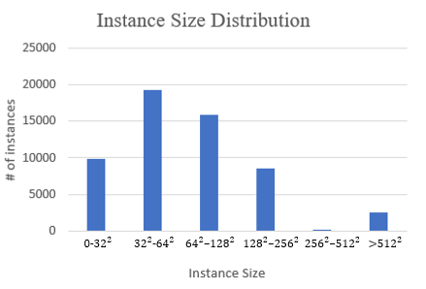
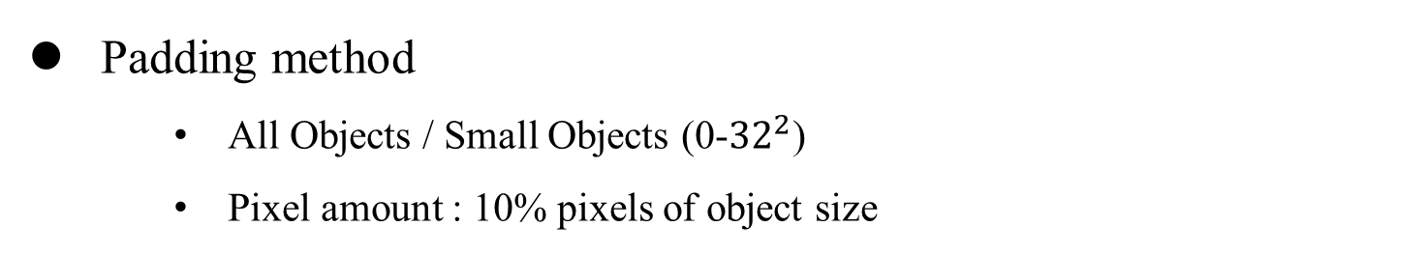
Object Padding
Padding method
All Objects / Small Objects (0-${32}^{2}$)
Pixel amount : 10% pixels of object size
Accuracy of Padding
Padding all objects
decreases detection accuracy.
↓
9
Notes:
전체 paddin을 할지 small objec만을 padding 진행할지 실험 주변을 아우르는 pixel은 전체의 가로 세로의 10%정도로 설정.
Padding이 전체 detection accuracy에 영향을 끼치는지 실험, 모든 object 해야할지, 작은 object만 진행해도 괜찮은지 실험.
실험 결과

Slide 10
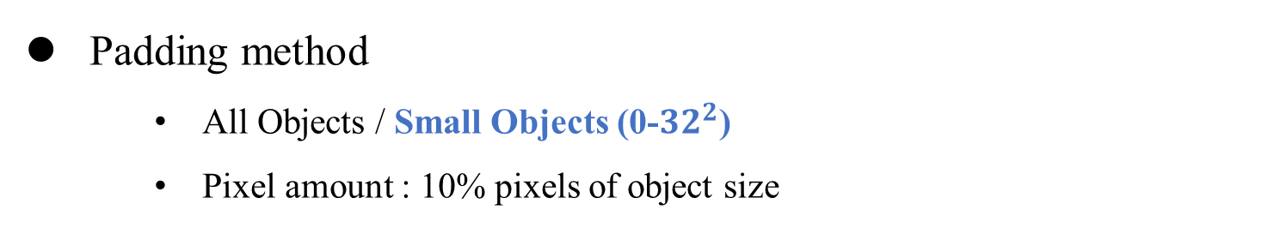
Object Padding
Padding method
All Objects / Small Objects (0-${32}^{2}$)
Pixel amount : 10% pixels of object size
Accuracy of Padding
Padding all objects
decreases detection accuracy.
2. Padding small objects with 10% pixel
merely increases detection accuracy.
Experiments
Appropriate padding amount.
Small Object Increment
10
Notes:
전체 paddin을 할지 small objec만을 padding 진행할지 실험 주변을 아우르는 pixel은 전체의 가로 세로의 10%정도로 설정.
Padding이 전체 detection accuracy에 영향을 끼치는지 실험, 모든 object 해야할지, 작은 object만 진행해도 괜찮은지 실험.
실험 결과

Slide 11
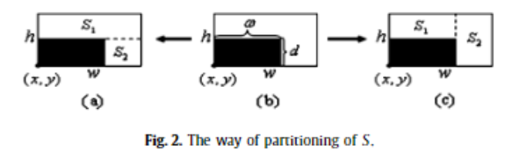
Image Patching Algorithm
Image Patching
Objective : maximize space utilization
Recursive packing
Minimum gap of optimal packing
[1] Zhang, Defu, et al. "A priority heuristic for the guillotine rectangular packing problem." Information Processing Letters 116.1 (2016): 15-21.
11

Slide 12
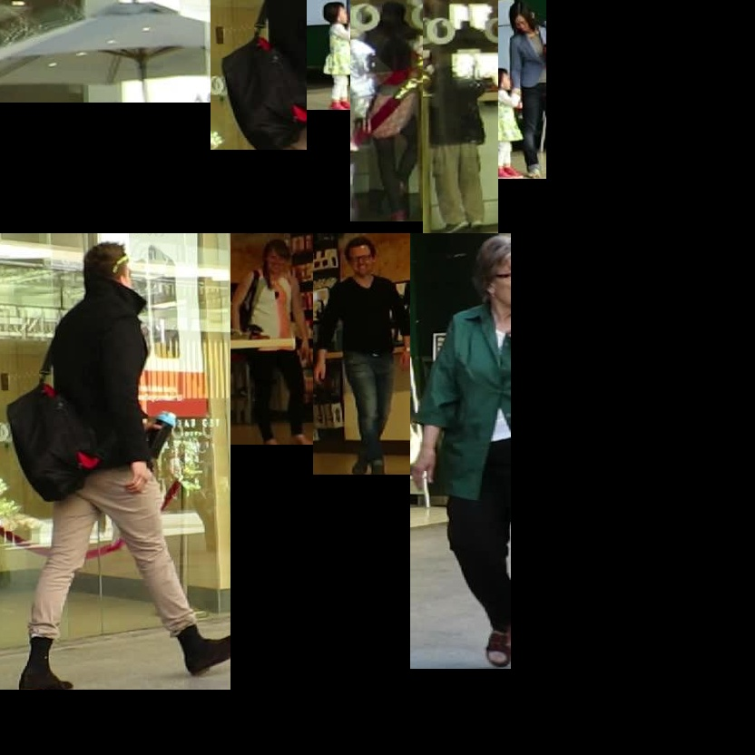
Image Patching Algorithm
Image Patching
Objective : maximize space utilization
Recursive packing
12

Slide 13
Image Patching Algorithm
Image Patching
Objective : maximize space utilization
Recursive packing
13

Slide 14
Image Patching Algorithm
Image Patching
Objective : maximize space utilization
Recursive packing
14

Slide 15
To Do
Intuition of Merge & Patching
Accuracy related Experiments
Padding
Small object Increment
Implementation
Patching Algorithm
Multiple Input Images
Merge and resize whole image
Localization
Patching with original object size
Yolo detection
Detection Result
15
15
15

Slide 16
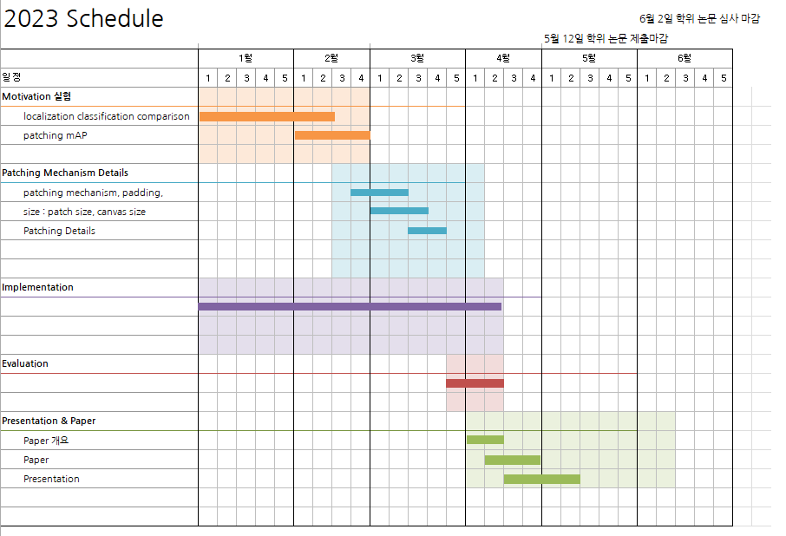
Plans
16
16
16

Slide 17

Advisor : Hoon Sung Chwa
Thank you
Dept of Information & Communication Engineering, DGIST
Real-Time Computing Lab
Kang Young Eun (kye0520@dgist.ac.kr)

Slide 18
Motivation Experiment
Execution time of localization per different image resolution
Merging images for localization is effective in terms of execution time.
18

